Slide 1

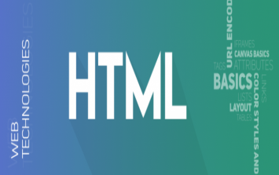
Front end
Web developmeNt
(Html)
Lecture-2

Slide 2
Today’s Agenda
Introduction To HTML
History of HTML
Components of HTML
Structure of HTML

Slide 3
INTRODUCTION
HTML is a language which instructs a web – browser that in what format the data should be displayed.
It contains commands that tells the browser how the embedded data is to be displayed on the web-page.

Slide 4
Conti.
HTML stands for Hypertext Markup Language, and it is the most widely used language to write Web Pages.
Hypertext refers to the way in which Web pages (HTML documents) are linked together.
Thus the link available on a webpage is called Hypertext.

Slide 5
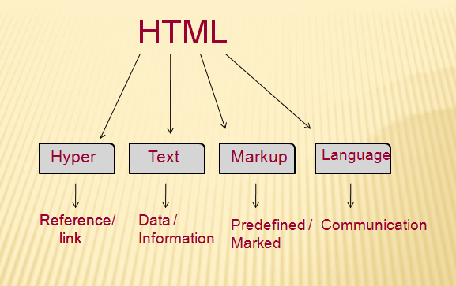
HTML

Slide 6
Conti.
As its name suggests, HTML is a Markup Language which means we use HTML to simply "mark up" a text document with tags that tell a Web browser how to structure it to display.
Originally, HTML was developed with the intent of defining the structure of documents like headings, paragraphs, lists, and so forth to facilitate the sharing of scientific information between researchers.

Slide 7
What kind of Application we are going to Develop?
Web Application
Front End
HTML(Content/Structure)
CSS(Designing/Presentation)
JavaScript(Actions/Behaviors)
Back End
Business Logic
Server Side Programming Language: Java, Python, C#, Node JS, PHP etc.
Data Store: (DBMS or RDBMS like Oracle, MySQL, MongoDB etc.)

Slide 8
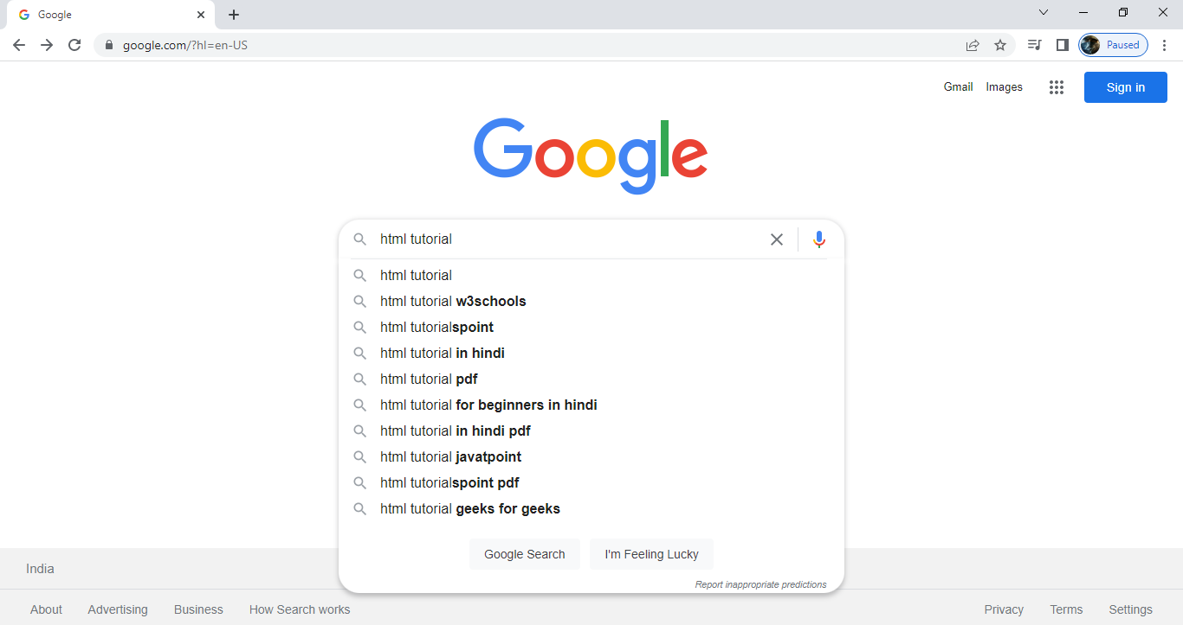
Example of
Hyper Link/Hyper Text

Slide 9
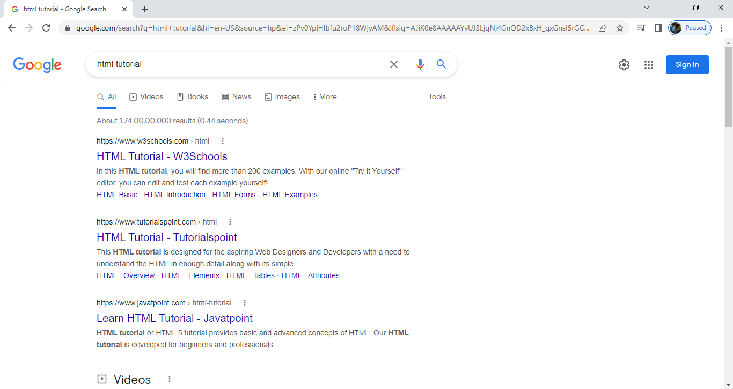
Example of
Hyper Link/Hyper Text

Slide 10
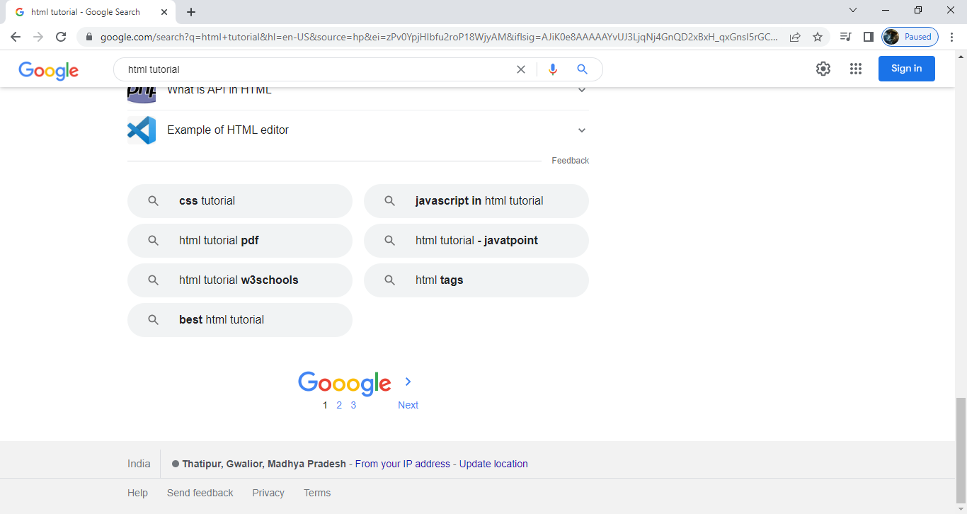
Example of
Hyper Link/Hyper Text

Slide 11
What type of Programming Language…
What type of Programming Language is C?
It is a Procedure Oriented Language.
What type of Programming Language is Python?
It is a General Purpose Programming Language.
What type of Programming Language is Java?
Java is an Object Oriented Language.
What type of Language is HTML?
HTML is not a programming language.
But it is a Mark Up Language

Slide 12
What type of Programming Language…
C
printf();
C++
cout<<;
Java
System.out.println();
Python
print()
HTML
< > </ >
Markup or Tag

Slide 13
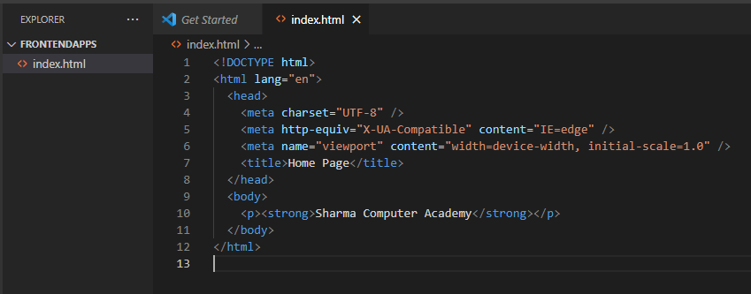
Screenshot of Code

Slide 14
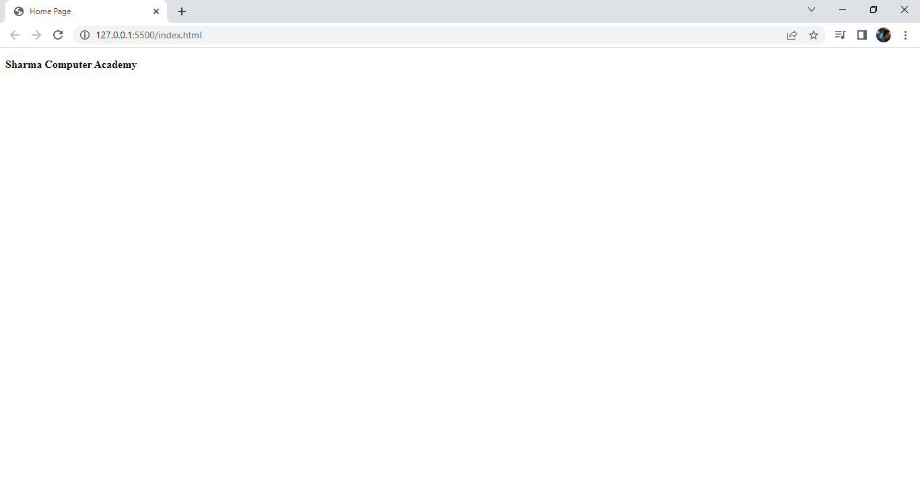
Output

Slide 15
Some Key Points About HTML
It stands for Hyper Text Markup Language
It is the backbone of every web page or web app.
This is because whatever content a WEB PAGE displays is always generated by the server using HTML.
4. It is NOT A PROGRAMMING LANGUAGE but it is a
DESIGNING/ MARKUP LANGUAGE.
5. An HTML page is rendered by a special software which is built inside our WEB BROWSER and it is called HTML ENGINE or HTML INTERPRETER.

Slide 16
Some Key Points About HTML
It is developed by Tim Berners Lee in the year 1990 – 1991 and initially it was used in defense lab of USA.
But in 1995 HTML was made commercial under the guidance of an organization called as W3C which stands for World Wide Web Consortium.
HTML’s most popular version was HTML 4.01 launched in 1999 and was 100% supported by every browser.
Today the current version of HTML is HTML 5.2 launched in 2014. (https://html5test.com/)

Slide 17
Some Key Points About HTML
10. HTML is a non case sensitive language.
11. That means we can write the tags in any case we want. But it is recommended that we write them in lower case.
12. Every HTML page must be saved with the extension “.html” or “.htm”.

Slide 18
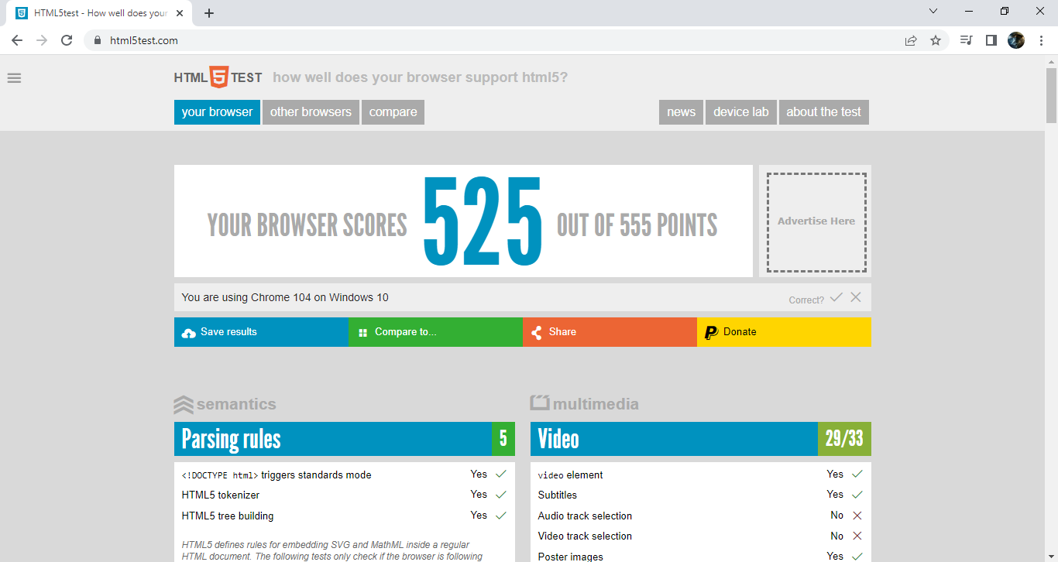
Screenshot of html5test.com

Slide 19
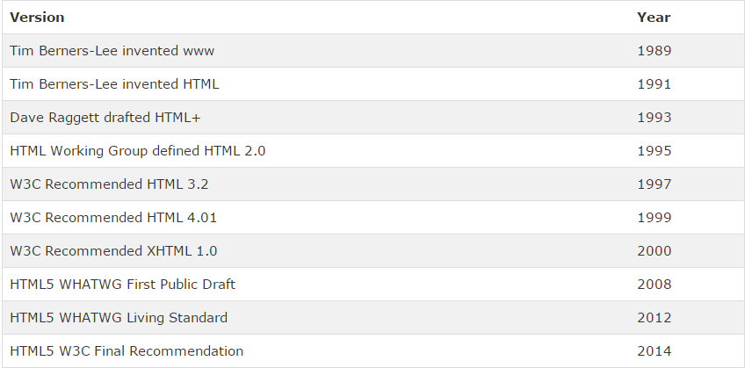
VERSIONS OF HTML

Slide 20
HISTORY
HTML was launched in 1995 .
HTML was created by Tim Berners-Lee in late 1991 but "HTML 2.0" was the first standard HTML specification which was published and available for commercial use in 1995 .
HTML 4.01 was a major version of HTML and it was published in late 1999.

Slide 21
Conti.
Though HTML 4.01 version is widely used but currently we are having HTML-5 version which is an extension to HTML 4.01, and this version was published in 2012.
It is a subset of more powerful language SGML(Standardised Generalised Markup Language) which itself is inherited from GML(Generalised Markup Language).

Slide 22
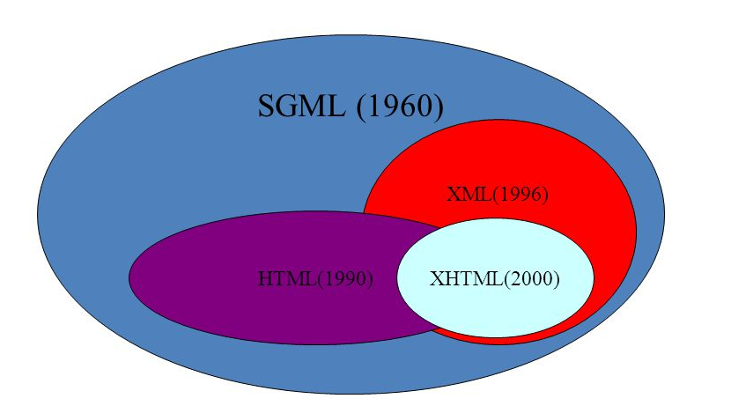

Slide 23
COMPONENTS OF HTML
Every HTML page consist of only 2 component :
Markup (Tags) : text embedded in angular bracket.
Content : text without angular bracket .

Slide 24
Conti
The difference between them is that browser can’t display markups instead markup contains information that tells the browser how to display the content.
Thus markup is a kind of ‘Metadata’ while content represents data.

Slide 25
Standard Structure
of an HTML Page
Standard Structure of a “C” Program:
//header file inclusion
//function declaration
int main()
{
//body
}
//function definition
Standard Structure of a HTML page:
<html lang="en">
<head>
//child tag of head tag
</head>
<body>
//child tag of body tag
</body>
</html>

Slide 26
Standard Structure
of an HTML Page
Standard Structure of a HTML page:
<!DOCTYPE html>
<html lang="en">
<head>
//we put those child tags here which convey some information about our page to the browser or the search engine
</head>
<body>
//content to be shown to the user
</body>
</html>

Slide 27
DOCTYPE
What is DOCTYPE?
The DOCTYPE is not a tag, rather it is an element which informs the browser that which HTML standard (4 or 5) the page developer is using.
If DOCTYPE is not mentioned, then it is up to the browser that which version of HTML it will assume and because of that the page might not render properly.
For HTML 5 the DOCTYPE is:
<!DOCTYPE html>

Slide 28
STRUCTURE OF HTML
Every HTML code consist of two sections :
<html>
HEAD
BODY
</html>

Slide 29
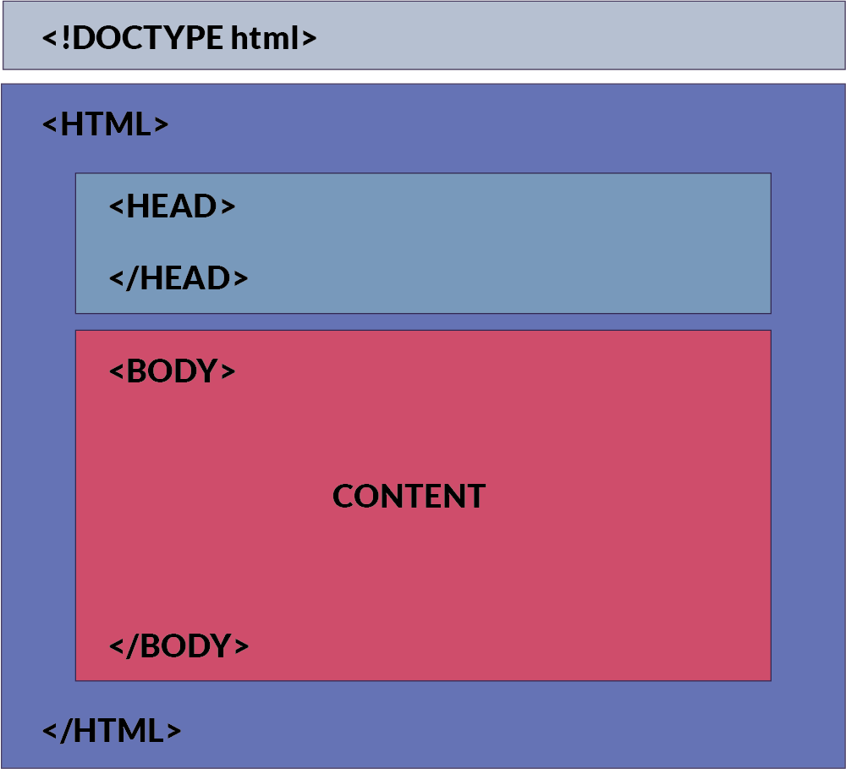
STRUCTURE OF HTML

Slide 30
Conti.
HEAD section contains information about HTML which is mostly used by browser and search engines.
This information is not mean for the users and isn’t directly displayed to the user.
BODY section mainly contains information which will be displayed to user.

Slide 31
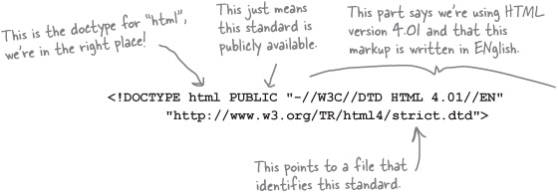
DOCTYPE -ELEMENT

Slide 32
DOCTYPE - ELEMENT
It is the starting element in HTML file.
<!doctype>if we not use in our html document then it browser dependent behaviour , browser consider it HTML 4.01 or HTML 5 .
It tells the browser that this HTML document is an HTML 4.01 document which confirms to standards set by W3C and written in English language.

Slide 33
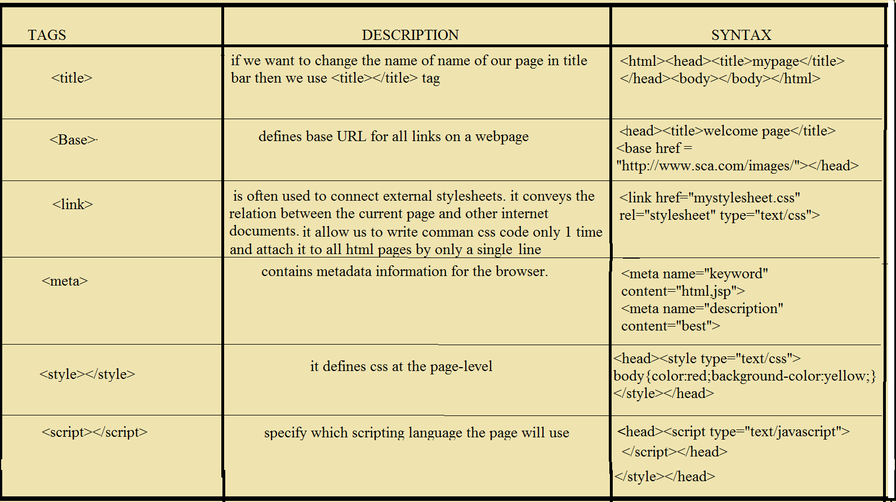
COMPONENT OF HEAD SECTION

Slide 34
Tools To Be Used For Developing and Running HTML Pages
Editor/Code Editior/IDE: Notepad, Notepad++, Sublime Text, Atom, Brackets, VS CODE
Browser: Any modern browser will work like Chrome, Firefox, Edge, Opera etc.
We will be using VS CODE and Chrome as the browser

Slide 35
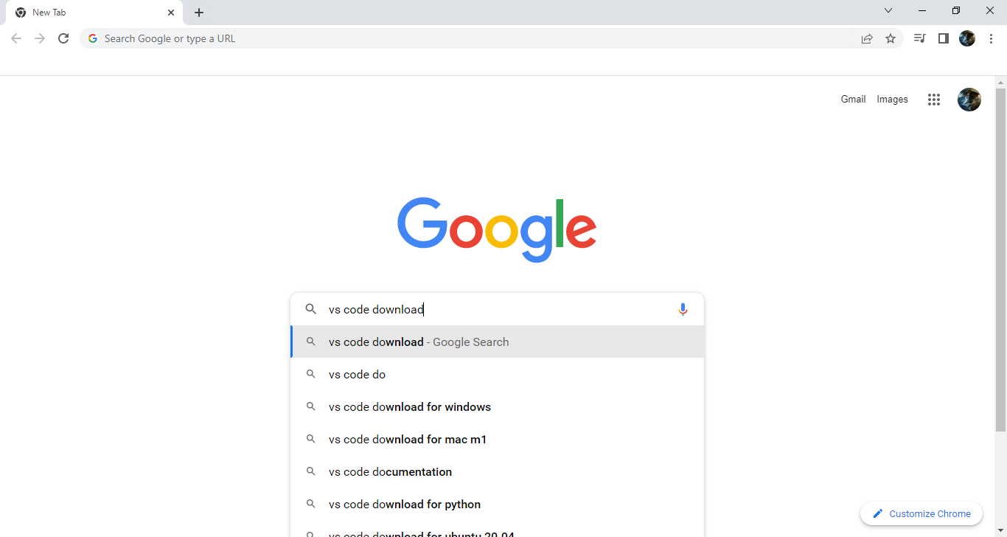
Screenshot related to VS Code

Slide 36
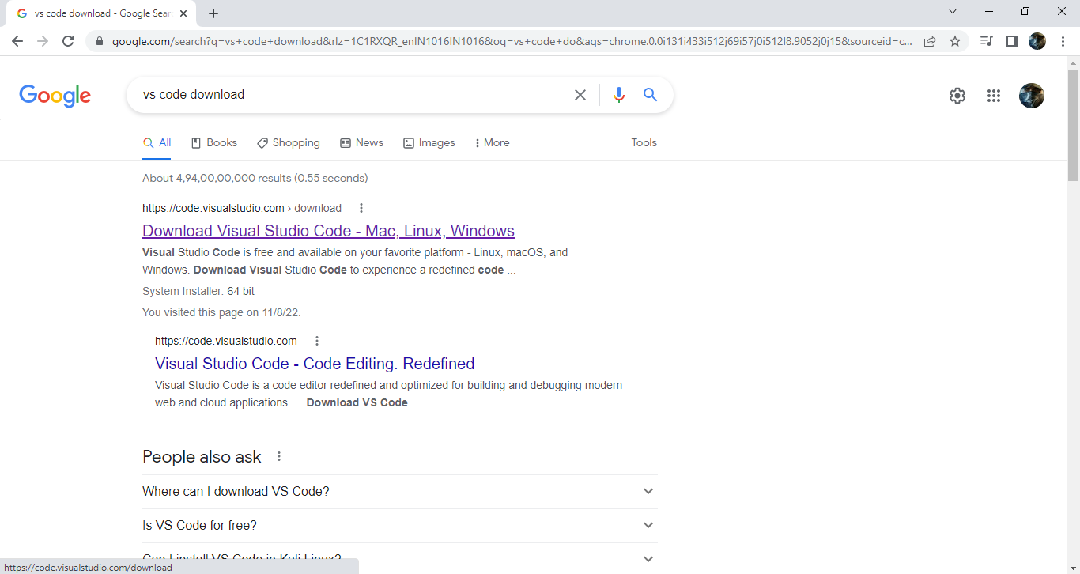
Screenshot related to VS Code

Slide 37
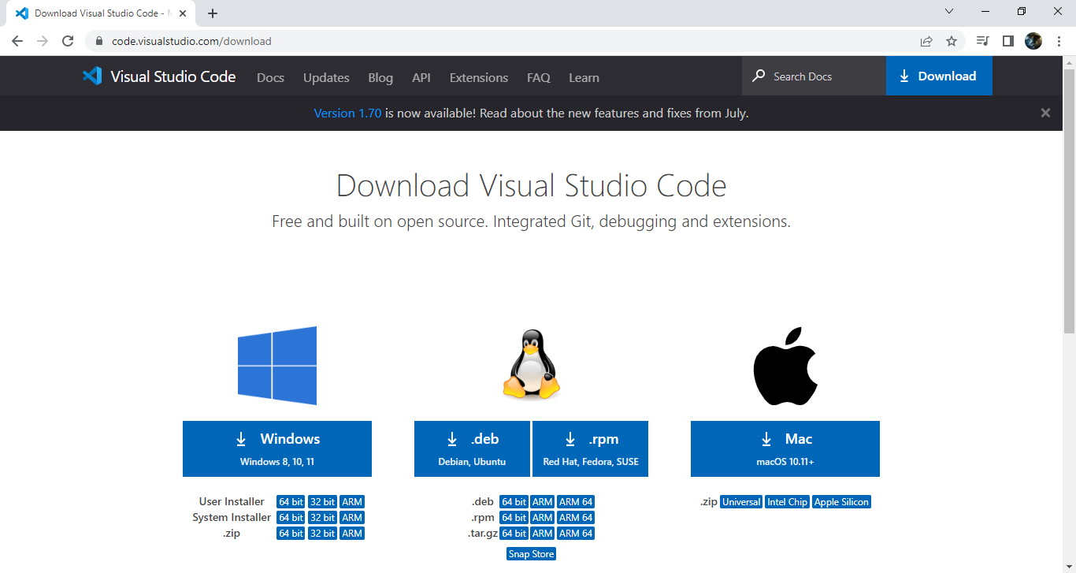
Screenshot related to VS Code

Slide 38
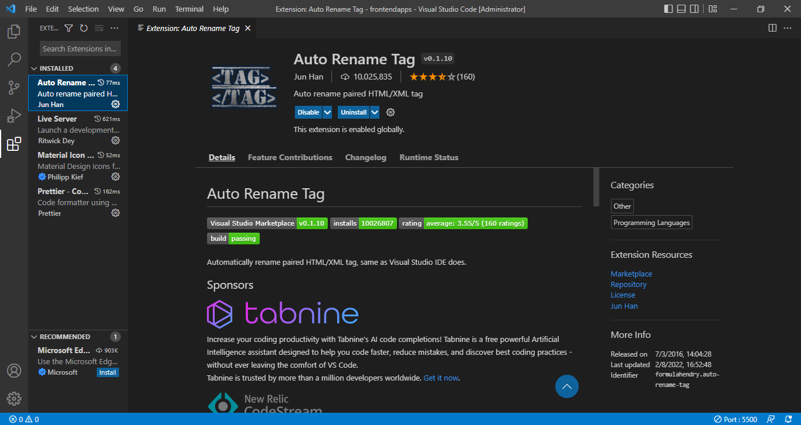
Screenshot related to Extensions to be install on VS Code

Slide 39
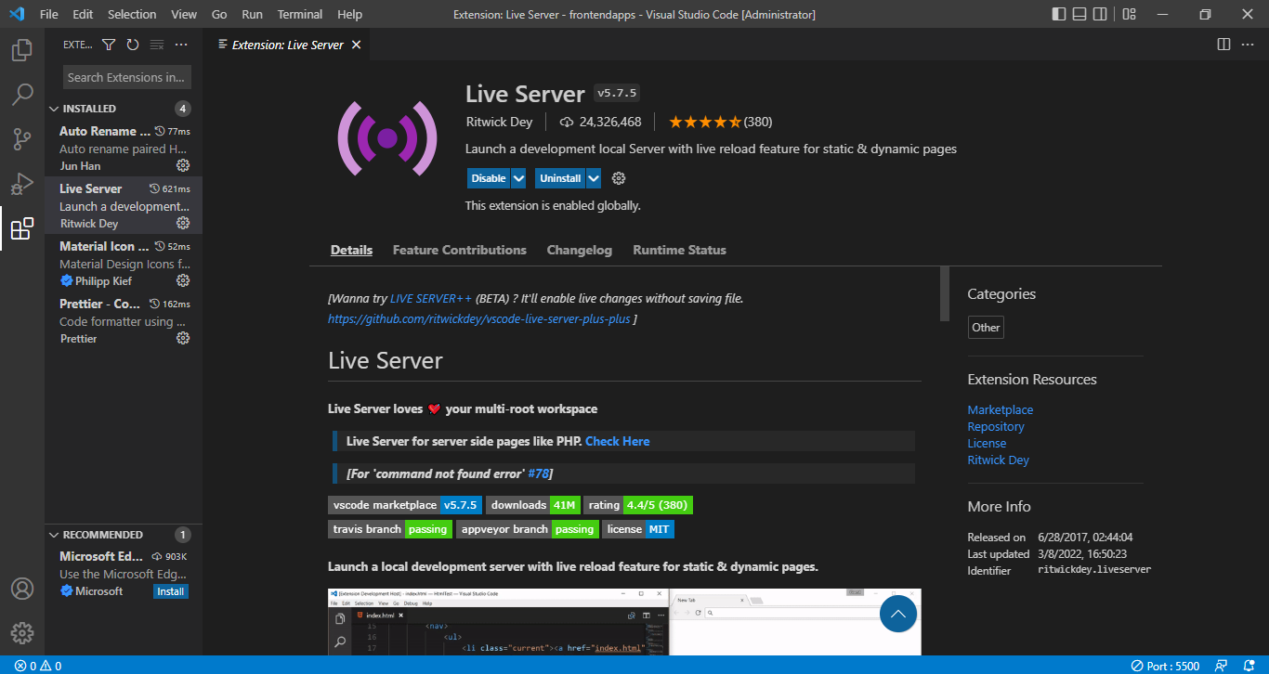
Screenshot related to Extensions to be install on VS Code

Slide 40
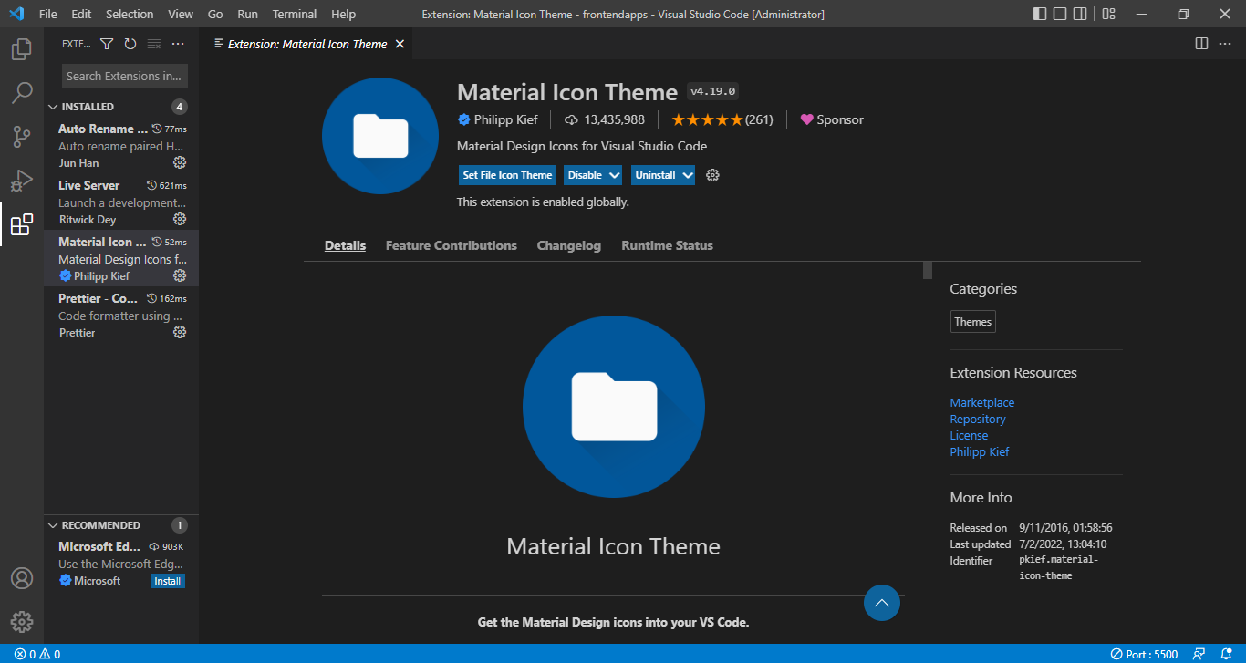
Screenshot related to Extensions to be install on VS Code

Slide 41
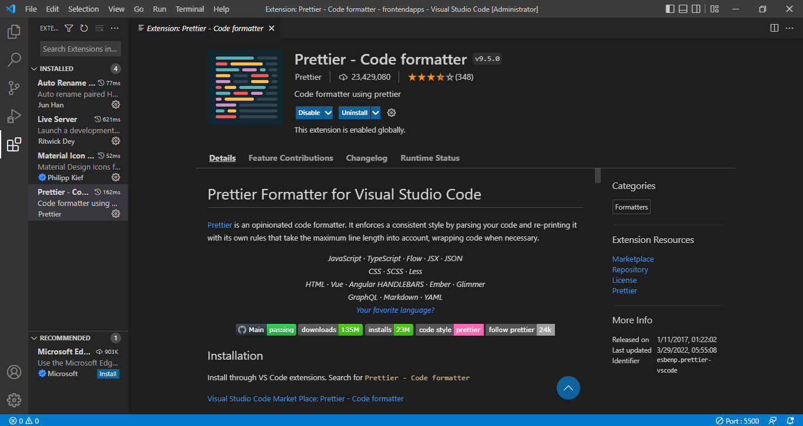
Screenshot related to Extensions to be install on VS Code

Slide 42

END OF LECTURE
For any queries mail us @: scalive4u@gmail.com
Call us @ : 0755-4271659, 9826686245
Agenda for Next Lecture:
The <body> Tag
Different categories of tags
Inline v/s Block elements

